Slide 1

Predictive Analytics for Business Strategy

Slide 2
By the end of this class, you should be able to:
Explain what a control variable is and what it is used for (as well as what kinds of models it is used in).
Discuss and explain multiple guidelines for selecting/excluding control variables for your model to be used for active prediction.

Slide 3
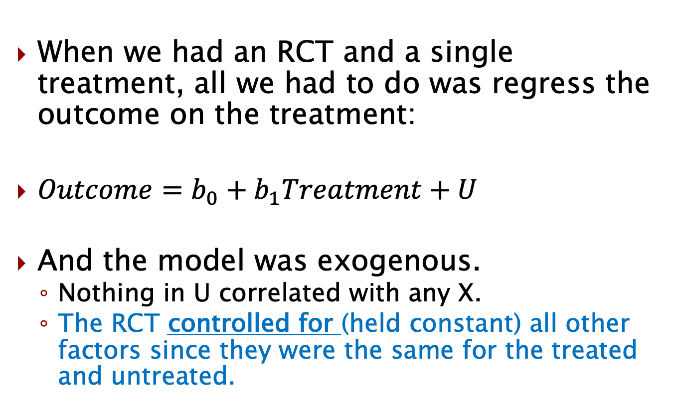
Model for RCT was exogenous
When we had an RCT and a single treatment, all we had to do was regress the outcome on the treatment:
$Outcome=b_{0}+b_{1}Treatment+U$
And the model was exogenous.
Nothing in U correlated with any X.
The RCT controlled for (held constant) all other factors since they were the same for the treated and untreated.

Slide 4
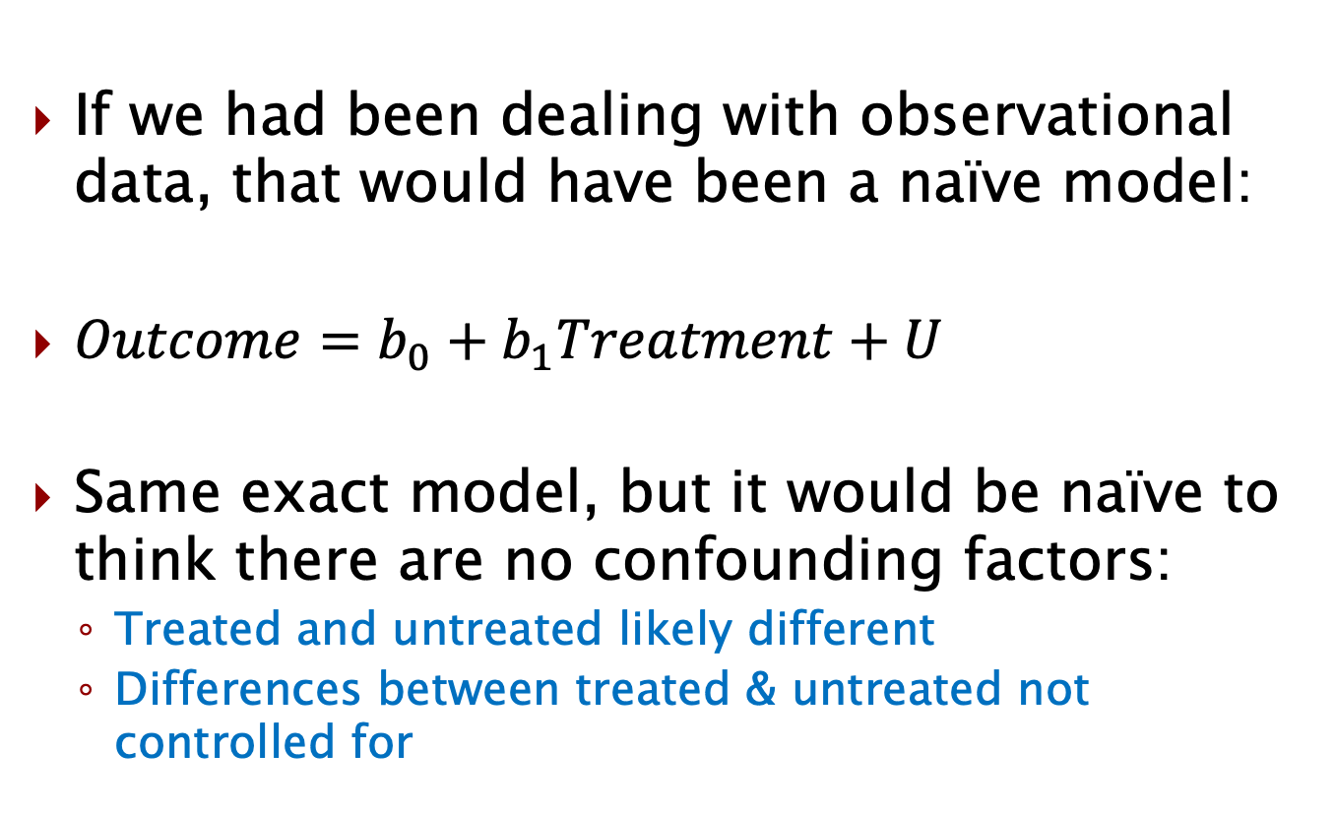
A naïve model
If we had been dealing with observational data, that would have been a naïve model:
$Outcome=b_{0}+b_{1}Treatment+U$
Same exact model, but it would be naïve to think there are no confounding factors:
Treated and untreated likely different
Differences between treated & untreated not controlled for

Slide 5
Data on confounding factor
What if we had data on something that we have identified as a confounding factor?
We think it is a difference between the treated and untreated (& in U).
What can we do with this data?
Well, we don’t have to leave it out in U
We can include it as an X variable and control for the the differences between the treated & untreated in that variable.
Let’s take a look at an example.

Slide 6
Effect of # of bathrooms on home price

Slide 7
Effect of bathrooms on home price
Let’s consider some synthetic data and look at the effect of the number of bathrooms on home prices.
Use Class 5.1 Control variables
Home Price worksheet
reg price bathrooms
Suppose we are interested in the causal impact of # bathrooms.
What else might correlate with the number of bathrooms?
How does that impact our current results if we do not include that in our model?

Slide 8
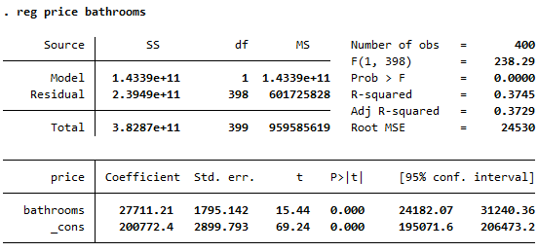
Effect of bathrooms on home price

Slide 9
What does it mean to control for # bedrooms?
There are likely other factors that would directly impact the market price of the home.
And typically price would be our independent variable.
But let’s use this data to illustrate what we mean by controlling for another factor, like # of bedrooms
Let’s do a few things:
reg price bathrooms if bedrooms == 2
reg price bathrooms if bedrooms == 3
reg price bathrooms if bedrooms == 4

Slide 10
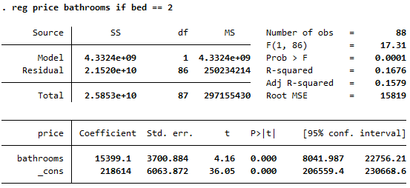
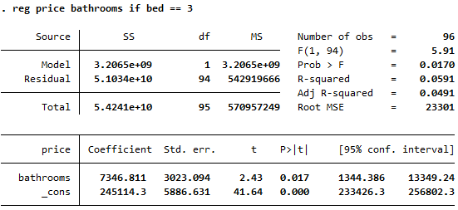
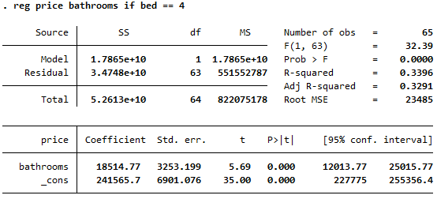
What does it mean to control for # bedrooms?

Slide 11
Controlling for # of bedrooms
We see very different effects at different levels of bedrooms
In fact, each one of the effects conditioned on the # of bedrooms is actually lower than the unconditional effect of bathrooms on price.
Consider what we’re doing when we add the # of bedrooms to the model:
We hold constant (or hold fixed, or control for) the # of bedrooms.
Our coefficient on bathrooms is now actually how much higher/lower the price is with an extra bathroom, holding fixed the number of bedrooms.

Slide 12
Let’s look at a graphical version
We’ll look at a different example later where we hold constant something that is binary, but you can kind of see in this graph that the correlational effect of bathrooms on price is higher when we don’t control for bedrooms.
twoway (scatter price bathroom if bed == 2, mcolor(red)) (scatter price bathroom if bed == 3, mcolor(purple)) (scatter price bathroom if bed == 4, mcolor(black))

Slide 13
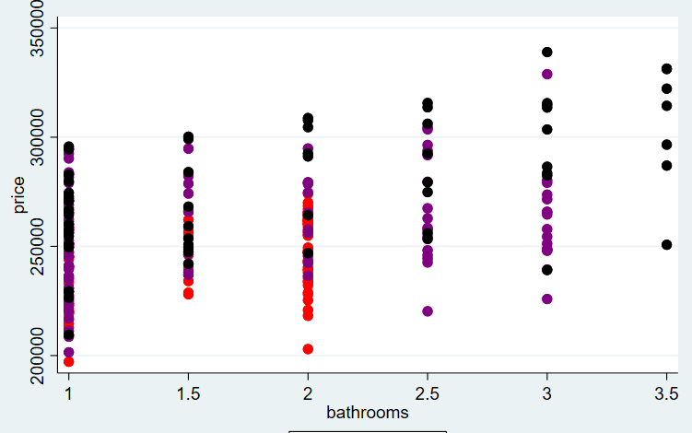
#bedrooms ( 2 vs 3 vs 4)

Slide 14
But we can just control for # bedrooms
We just looked at an example where we could in fact control for a variable like # of bedrooms.
But typically, the reason a confounding factor will be in U is that we don’t have data on it (it is unobserved).
Let’s take a look at the effect of # of years of education on annual wage (for adults of a similar age).

Slide 15
Effect of # of years of education on annual wage

Slide 16
Class 5.1.xlsx (Wage)
Plot the data (try to estimate the slope)
twoway scatter Annual Years || lfit Annual Years
twoway scatter Annual Years if High >0 || lfit Annual Years
twoway scatter Annual Years if High <1|| lfit Annual Years

Slide 17
Let’s run the regressions now
reg AnnualWage Years_Edu if High > 0
reg AnnualWage Years_Edu if High < 1
reg AnnualWage Years_Edu (****)
Can we observe cognitive ability here?
What impact does that have on our results?

Slide 18
Let’s run the regressions now
reg AnnualWage Years_Edu if High > 0
reg AnnualWage Years_Edu if High < 1
reg AnnualWage Years_Edu (****)
Can we observe cognitive ability here?
What impact does that have on our results?
What do we mean when we say we “control for” or “hold constant” some factor X?

Slide 19
Holding constant Cognitive ability
twoway (scatter Annual Years if HighCog == 1, mcolor(red)) (scatter Annual Years if HighCog == 0, mcolor(black))
Imagine estimating the relationship between education and wage:
If there was only one color
Average over everyone
With both colors
Average effect, controlling for HighCognitive
We typically can’t observe this though!

Slide 20
Estimating a causal effect
Now that we understand control variables a bit better, we’ll turn our focus to models for active prediction using observational data.
What do they need to achieve?
How do we decide what control variables to put in the model?

Slide 21
Estimating the effect on our variable of interest

Slide 22
Variable of interest
If models to be used for active prediction, the variable of interest is the only thing that really matters.
Only coefficient we need to be significant
How do we decide what other variables to include in our model?
What is our goal when we add any other variable to a model?

Slide 23
Unobservables
Unfortunately, we often don’t have data on things like “high cognitive ability”
This lack of data (unobservable) is the main reason a confounding factor is in U and not a control variable (another X but not variable of interest).
Let’s define what a control variable is and then discuss how we choose what to put in our model.

Slide 24
Control Variable
A control variable is any variable included in a regression equation whose purpose is to alleviate an endogeneity problem.
Essentially, you are trying to include, and hence control for, a confounding factor(s)

Slide 25
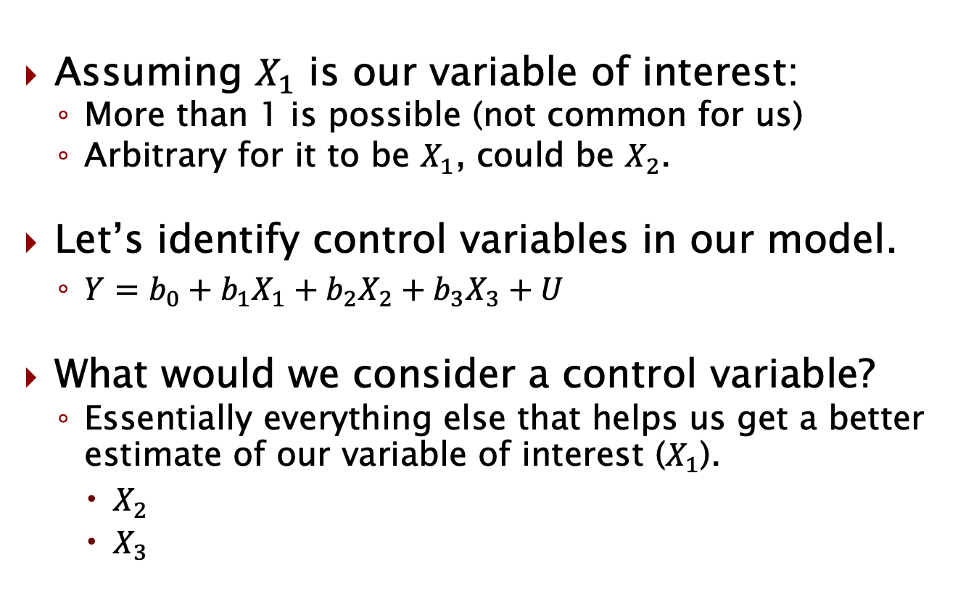
Controls in our model
Assuming $X_{1}$ is our variable of interest:
More than 1 is possible (not common for us)
Arbitrary for it to be $X_{1}$, could be $X_{2}$.
Let’s identify control variables in our model.
$Y=b_{0}+b_{1}X_{1}+b_{2}X_{2}+b_{3}X_{3}+U$
What would we consider a control variable?
Essentially everything else that helps us get a better estimate of our variable of interest ($X_{1}$).
$X_{2}$
$X_{3}$

Slide 26
How to choose our controls?
How to select controls?
Unfortunately, there is no universally accepted method to do this when estimating treatment effects
However, there are some important and useful guidelines for the process
Guideline #1: Theory
Is there a plausible theoretical explanation as to why the candidate control variable might impact the outcome?

Slide 27
Control Variables
Why is theoretical justification so important?
It helps eliminate the act of “fishing” for results
Specifically, we don’t want to simply throw in lots of different variables in many combinations until we find a result we “like”
This is an undesirable form of data mining

Slide 28
Control Variables
How to use theory as a guide?
Consider variables that 1) should, or 2) could affect the outcome
Variables that should affect the outcome:
Those for which theory clearly indicates a relationship ought to exist
Variables that could affect the outcome:
Those for which theory suggests a relationship might exist

Slide 29
Control Variables
As may seem obvious, you should always include variables theory indicates should affect the outcome. This is because:
Highly likely to help us get a more accurate estimate
They help play the role of a “sanity check” – what do we mean by this?
A sanity check example:
If you are estimating demand for a clearly normal good, and find the coefficient on income is negative, your data may have issues
In contrast, finding a sensible positive coefficient can help generate greater confidence that your data are not flawed
But doesn’t ensure our model is exogenous.

Slide 30
Control Variables
For the variables that could affect the outcome, should we include them all?
Not necessarily…There are tradeoffs when deciding whether to keep a control:
If related to outcome and treatment, keep
Mitigation of endogeneity concern
If related to outcome, keep
Improvement in precision of parameter estimates
If unrelated to outcome (i.e., irrelevant), discard
Can worsen precision of parameter estimates – particularly when related to the treatment(s)

Slide 31
Control Variables
Summary of using theory to guide control variable selection:
Identify variables that theoretically should or might affect the outcome
Include variables that theoretically should affect the outcome
Regardless of whether they are significant or not. Why?
For variables that theoretically might affect the outcome, include those that prove to affect the outcome empirically through a hypothesis test & discard those that don’t.

Slide 32
Coefficient on variable of interest
Guideline #2 (but not a hard and fast rule):
Check the coefficient on the variable of interest.
When adding/removing a control variable, see if it affects the coefficient on the variable of interest.
If it moves in the “correct” direction, that is a good sign.
Be very careful here though. Sometimes our intuition of the “correct” sign isn’t always correct.
The causal effect of price on quantity should be negative, but others we should be more cautious.

Slide 33
How many control variables to add?
Anything that would have been a confounding factor and/or improves our estimate of the variable of interest.
Model more likely exogenous
And/or coefficient on variable of interest lower p value
It will always be a case-by-case basis.
And control variables will rarely make our model fully exogenous.
Why?

Slide 34
What we don’t observe
We talked in the WWII plane example about data points we didn’t observe.
Hopefully we’ll have a random (or at least “representative”) sample and won’t be missing a specific chunk of our population.
But, there will likely be variables that we don’t observe. What do we do about those?
Stay tuned…

Slide 35
Wrapping up
We learned that a control variable reduces the endogeneity issues for a model to be used in active prediction.
It controls for (or holds constant) that variable when considering the effect of the variable of interest.
We also discussed some things to consider when choosing control variables to include/exclude for a model.
Ultimately, do they help us:
Be more confident our model is exogenous
Help us get a better estimate for the variable of interest.

Slide 36
Announcements/reminders
Quiz 2 is this Friday
Discussion Forum 2 is due this Sunday

